Slide 1
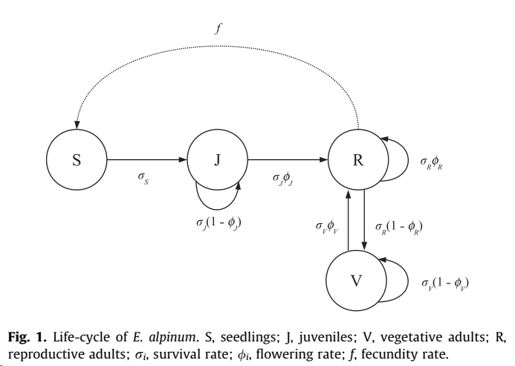
Analysis of vital rates
Survival probability, σ, J, V, R
Flowering probability, φ, J, V, R
Fecundity, f

Slide 2
Environmental predictors Years 2014-2021, iButton data
Calculation on interval between snowmelt day up to 120 days later
snowmelt: first two days with T > 0 after March 15th
Two variables:
ddays: Degree days: should be correlated positively to vital rates
num_s_Tmin_15: Number of stressful hot periods: number of periods with at least 3 consecutive days with Tmin > 15 °C should be correlated negatively to vital rates

Slide 3
Analysis of survival probability
GLMM – Bernoulli
surv(0,1) ~ State[J,V,F] * Site * (ddays + num_s_Tmin_15) + (1| ID)
Model selection (AIC):
surv(0,1) ~ State[J,V,F] * Site + (ddays + num_s_Tmin_15)
Individual as random term (repeated measures)

Slide 4
